Slide 1

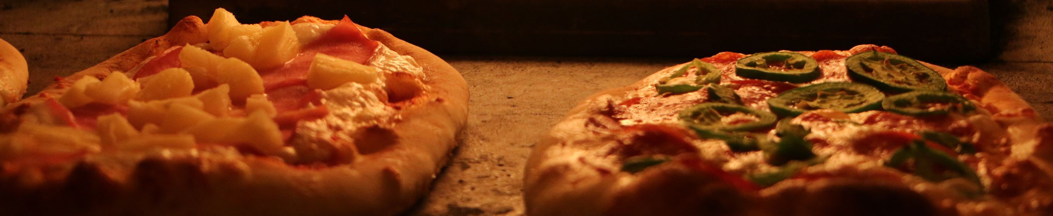
RESTAURANT
Specialist in Italian Food

Slide 2
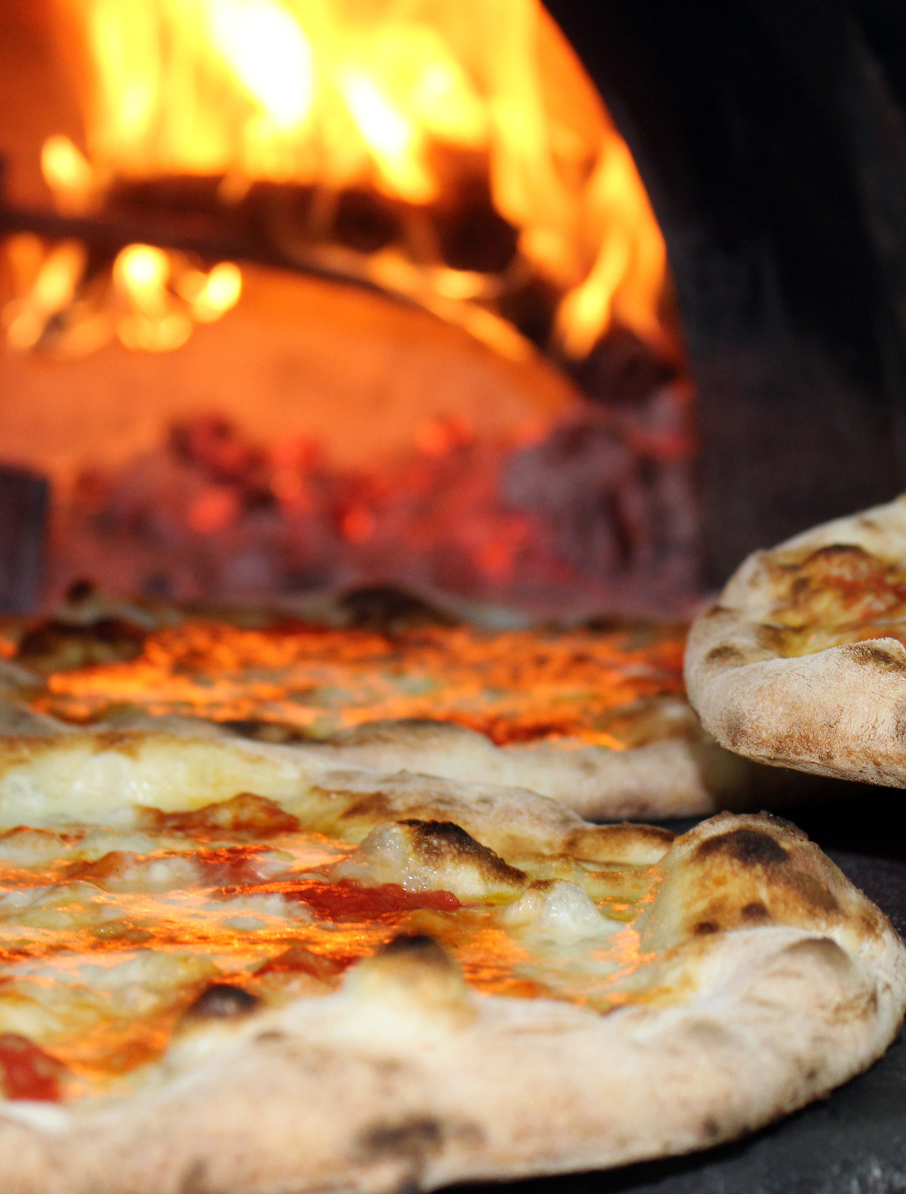
BORCELLE
RESTAURANT
OBJECTIVE
Explore the menu_items table to get an idea of what’s on the new menu.
Explore the order_details table to get an idea of the data that been collected.
Use both tables to understand how customers are reacting to the new menu.

Slide 3
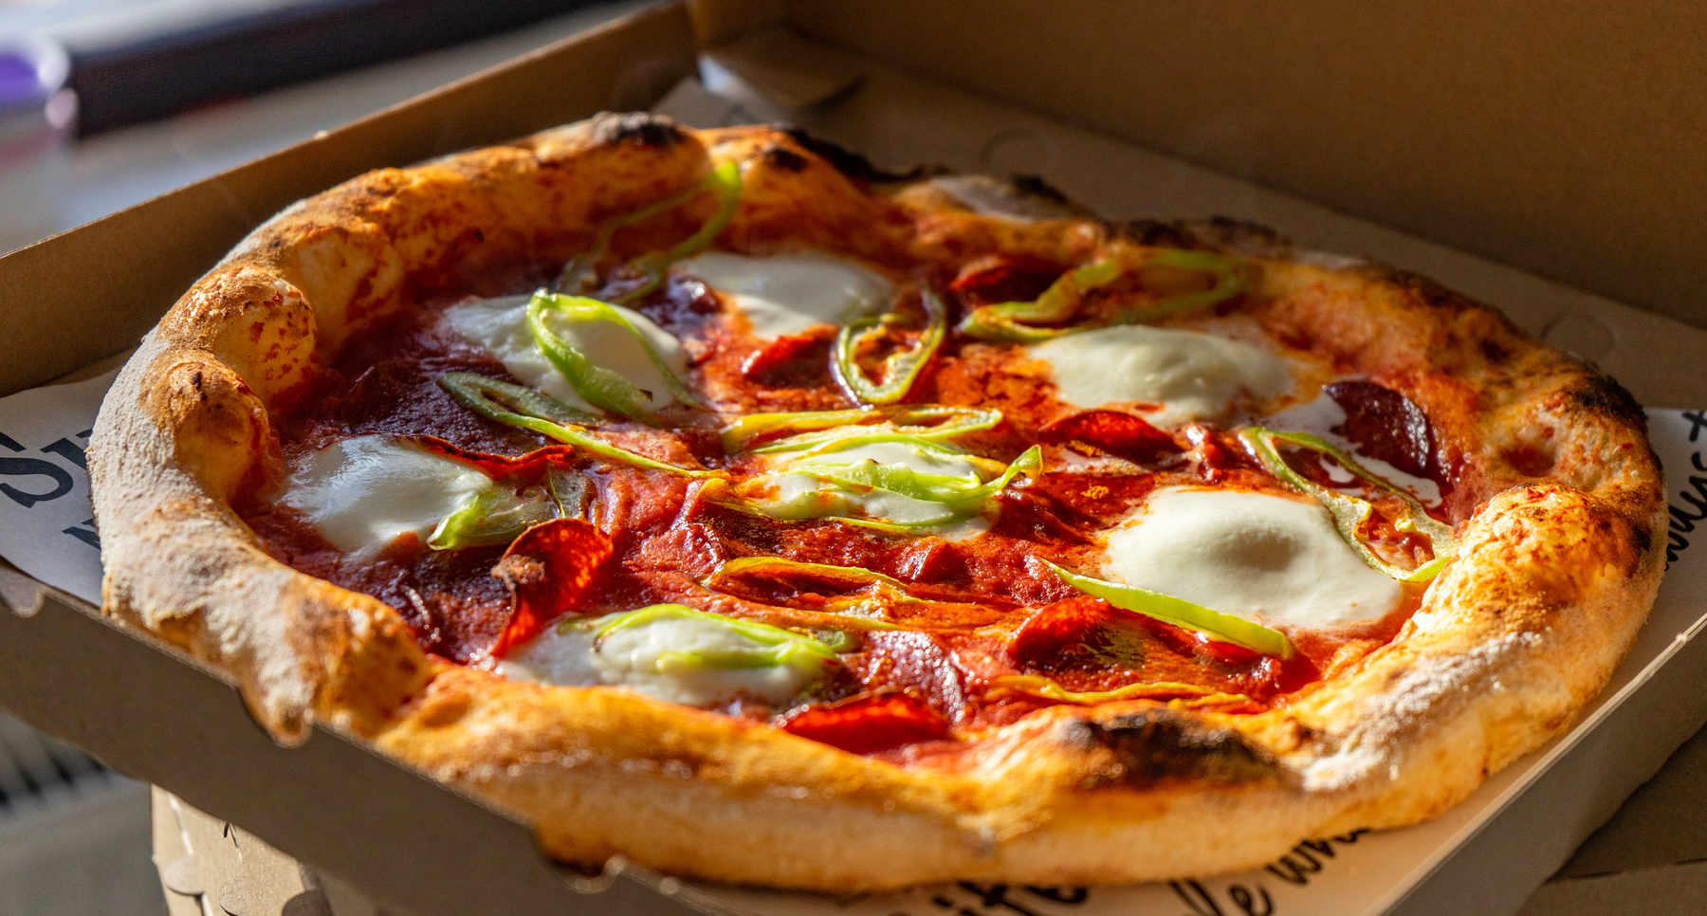
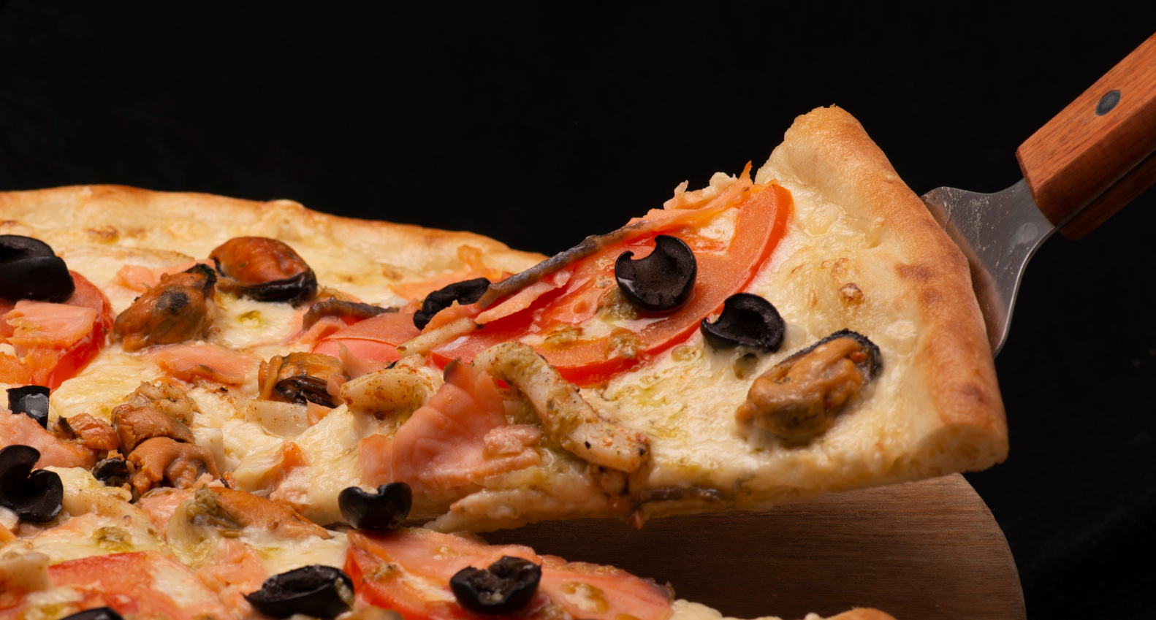
BORCELLE
RESTAURANT
ASSIGNMENT
You’ve been asked to dig into the customer data to see which menu items are doing well not well and what the top customers seem to like best.

Slide 4
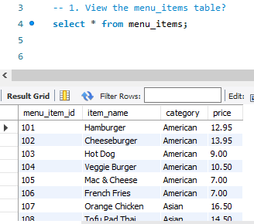
BORCELLE
RESTAURANT
QUESTIONS
1. View the menu_items table?

Slide 5
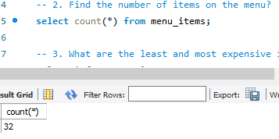
2. FIND THE NUMBER OF ITEMS ON THE MENU?

Slide 6
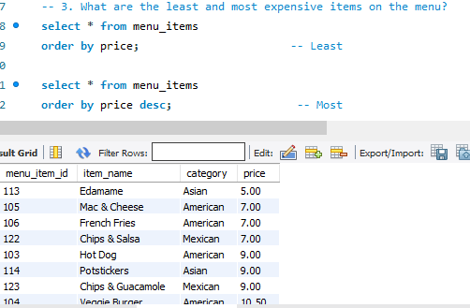
3. WHAT ARE THE LEAST AND MOST EXPENSIVE ITEMS ON THE MENU?

Slide 7
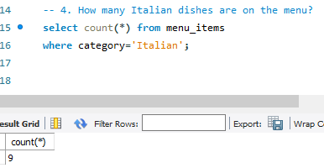
4. HOW MANY ITALIAN DISHES ARE ON THE MENU?

Slide 8
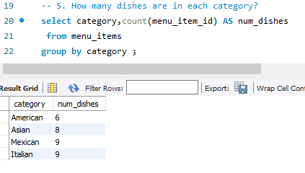
5. HOW MANY DISHES ARE IN EACH CATEGORY?

Slide 9
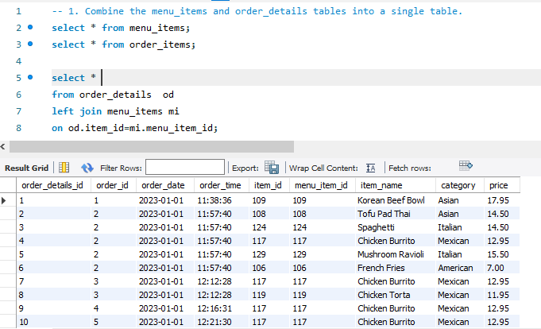
6. COMBINE THE MENU_ITEMS AND ORDER_DETAILS TABLES INTO A SINGLE TABLE.

Slide 10
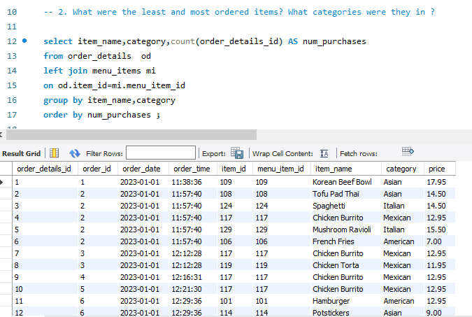
7. WHAT WERE THE LEAST AND MOST ORDERED ITEMS? WHAT CATEGORIES WERE THEY IN ?

Slide 11
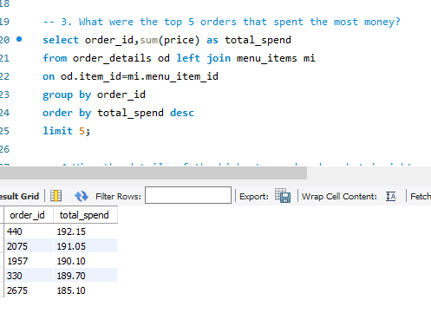
8. WHAT WERE THE TOP 5 ORDERS THAT SPENT THE MOST MONEY?

Slide 12
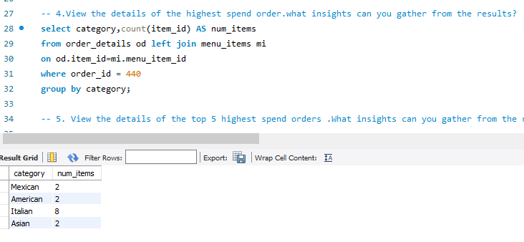
9.VIEW THE DETAILS OF THE HIGHEST SPEND ORDER.WHAT INSIGHTS CAN YOU GATHER FROM THE RESULTS?

Slide 13
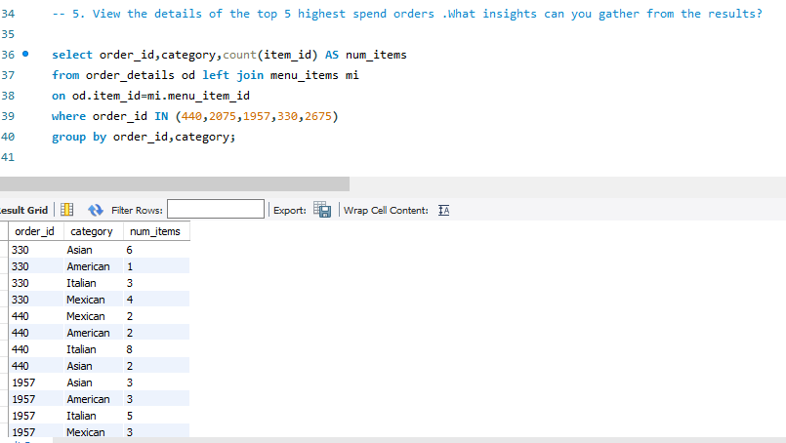
10. VIEW THE DETAILS OF THE TOP 5 HIGHEST SPEND ORDERS .WHAT INSIGHTS CAN YOU GATHER FROM THE RESULTS?

Slide 14
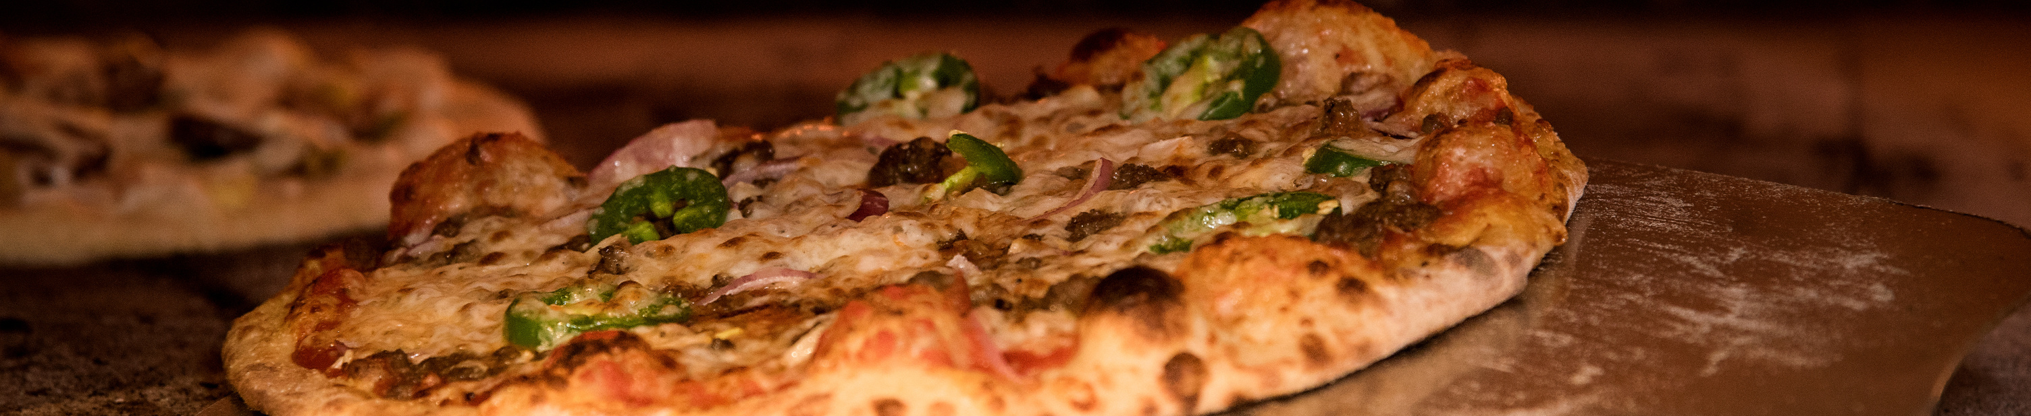
BORCELLE
RESTAURANT
THANK YOU

